Slide 1



How did We Come to Microservices? History and Driving Forces Audience: All

Slide 2
Introduction
How did We Come to Microservices?
Who I am: <Instructor Name>
Title
Organization
Role
Background

Slide 3
Agenda
Microservices Prerequisites
Microservices – History, Driving Forces, and Definition
Microservices Patterns
DevOps
Reactive Microservices
1
5
9
13
AD
All
D
AD
A
Microservices Prerequisites
Integration
Securing Microservices
Testing
2
6
10
14
AD
AD
A
D
A
A
Spring Boot
Migrating Monoliths to Microservices
Domain Driven Design Testing
Scaling Microservices
3
7
11
15
AD
D
A
A
A
Case Study
Cloud
UI
Microservices Anti-Patterns
4
8
12
16
AD
AD
All
All
A
A
Legend: All Developer Advanced Developer Architect
All
D
AD
A

Slide 4

Objectives
How did We Come to Microservices?
At the end of this training, you should be able to:
Describe the challenges in operating environment that pave way for Microservices
Define Microservices and their characteristics
Analyze the reasons that lead to adoption of Microservices
Understand the challenges posed while operating in the Microservices environment
Define Cloud, DevOps, and Agile, and how they work in tandem with Microservices

Slide 5
Topics
How did We Come to Microservices?
History of Microservices
Definition Characteristics | Benefits Complexities
Driving Forces for the Move to Microservices
Cloud Complexity of Operating Environment Customer Expectations | Agile DevOps

Slide 6
History of Microservices

Slide 7

Microservices: Example
How did We Come to Microservices?
Consider a monolithic shopping cart application that has the following components.
Web / mobile interfaces
Functions for:
Searching for products
Product catalog
Inventory management
Shopping cart
Checkout
Fulfillment
How would this look with Microservices?
Notes:
So lets start by thinking about a traditional shopping cart application. Something with a web interface.
If you stop to think about the functional areas of such an application, you can probably think of several predictable items: we need a way to search for products, we need a way to store all of our products in some kind of catalog, probably in concert with some kind of inventory management. We have to let customers put items into shopping carts and go through a checkout process, and we have to think about order fufillment, and a number of other items that we don't have listed here.
Well how would this look in a microservices style architecture? Well, lets look at how a traditional monolith would look.

Slide 8

Monolithic Application: Example
How did We Come to Microservices?
The following chart displays a Monolithic shopping cart application.
Controllers
Services
DAOs
DB
Notes:
For a monolithic shopping cart application, we would probably take the familiar layer-cake approach backed by a traditional relational database.
We would have data access objects talk to our database to handle persistence, we would have our use-cases implemented by our service layer, and we would have a controller layer serving up traditional web pages to a traditional web browser.
We might have some dynamic JavaScript code on our pages talking to the controllers too, but everything is basically represented by this layered architecture.

Slide 9
Monolithic Application: Example (continued)
How did We Come to Microservices?
Understanding the Monolithic Architecture
Search
Reviews
Cart
Checkout
Contact
Search
Catalog
Reviews
Cart
Customer
Shipping
Payment
Order
Contact
Product
Inventory
Cart
Customer
Shipping
Payment
Order
Contact
DB
Notes:
Now if you take a closer look at those layers, you can see a lot more detail.
There are many different kinds of controllers for the different pages in the application, like the search page, product review page, cart display, the entire checkout process, and the “contact us” area of the site.
The service layer attempts to model our use-cases, and we probably have separate services to control search functions, catalog management functions, review function, cart functions, and so on.
At the DAO layer, things resemble the data model, and there are typically DAO objects representing each table, or perhaps small group of tables. So we have DAOs for products, inventory, cart, customers, and so on.
And you can expect that within the database, we have various tables setup to support the storage needs for the various parts of the application.
This application structure is well organized and well understood. So why is there a move to something different?

Slide 10
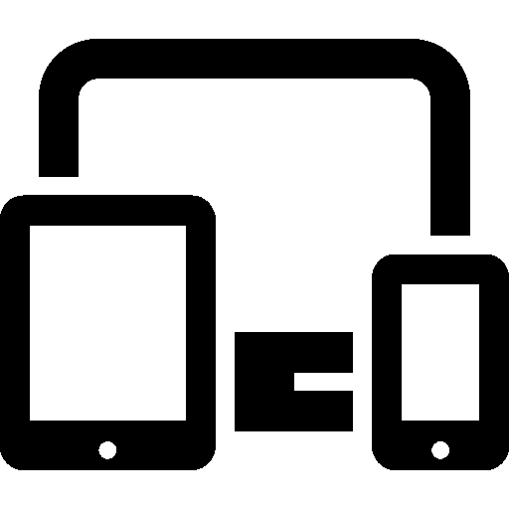

Monolithic Challenges
How did We Come to Microservices?
New types of client applications
Search
Reviews
Cart
Checkout
Contact
Search
Catalog
Reviews
Cart
Customer
Shipping
Payment
Order
Contact
Search
Product
Inventory
Cart
Customer
Shipping
Payment
Order
Contact
DB
Notes:
Well let's start to think about some of the challenges that we are facing at present in the industry.
Ten years ago, we only had to think about web interfaces; but, now we have a proliferation of client technologies. We have smart phones and tablets, we have game consoles and TVs, and now we even have watches and wearables.
The controllers that were designed for our web interface were not designed for these other channels. Plus, we have to think about the different kinds of networks like mobile networks that may be more sensitive to chatty interfaces.

Slide 11




Monolithic Challenges (continued)
How did We Come to Microservices?
New types of persistence/services
Search
Reviews
Cart
Checkout
Contact
Search
Catalog
Reviews
Cart
Customer
Shipping
Payment
Order
Contact
Search
Product
Reviews
Cart
Customer
Shipping
Payment
Order
Contact
DB
Notes:
We also have different types of persistence and back-end technologies to think about.
10 years ago most stored everything in relational databases, and these databases have been a fantastic one-size-fits-all solution for us for many years.
But now we have access to specialized technologies that offer superior performance for many use cases.
For example our product search is much faster and robust with elastic search,
things like product reviews are stored more flexibly in a document store like mongo
The shopping cart is a lot faster and simpler with a key/value store like redis.
Plus we still have needs to access legacy back-end technologies like SAP for orders and shipping, and we might decide it is much easier to let pay-pal handle all of the payments for us.
Now please don't think from this that relational databases are going away – they are still the swiss army knife of storage technology. The point is we are more likely to have a plethora of back-end technologies, and our single application written in a single language will have to stretch a bit to accommodate the various needs.

Slide 12





Monolithic Challenges (continued)
How did We Come to Microservices?
Single Codebase, Deployment, Versioning, and Team Size
Features
Test
Prod
Codebase
continuous
delivery
SCM
SCM – Source Code Management
Notes:
Here is another thing to think about: Our monolithic codebase is a single application, a single codebase. If it is small enough, it is pretty easy for a single team to implement features, manage source using source code management, and test and deploy, hopefully using some kind of continuous delivery pipeline.

Slide 13
Monolithic Challenges (continued)
How did We Come to Microservices?
Single Codebase, Deployment, Versioning, and Team Size
Features
Features
Features
Codebase
Test
Prod
continuous
delivery
SCM
Notes:
But here is the problem: what if the system is large and complex? What if there are large numbers of features that need to be implemented quickly? We'll need a large team, and inevitably we'll have a large codebase. Large teams are hard to manage, and so are large code bases.

Slide 14
Monolithic Challenges (continued)
How did We Come to Microservices?
Features
Features
Flaw discovered during
user acceptance testing
ALL features held up!
Features
Using Teams/Language Constructs
Codebase
Test
Prod
Codebase
Artifact
Codebase
continuous
delivery
SCM
Notes:
...so perhaps what we will do is break our big team down into little teams, each one working on a subset of features, and each one dedicated to maintaining their separate codebase for a single 'module' of a large application – like a JAR. Well this approach might mean that we need to have a separate team in charge of 'assembling' our separate modules into the completed application, and then subjecting the entire thing to our continuous delivery pipeline.
A big problem for all of this is what happens if a flaw is discovered late in the pipeline, such as user-acceptance testing. Now we can't deploy the application until we fix that problem, or at least back it out. Then the problem is that the assembly team is working to try to find the best versions of each team's components to deploy to get the optimal delivery of features delivered. And then they will be putting pressure on the original teams to fix specific issues in specific version of specific modules. So this is a big mess, and most of it has nothing to do with coding, but assembling and deploying.

Slide 15
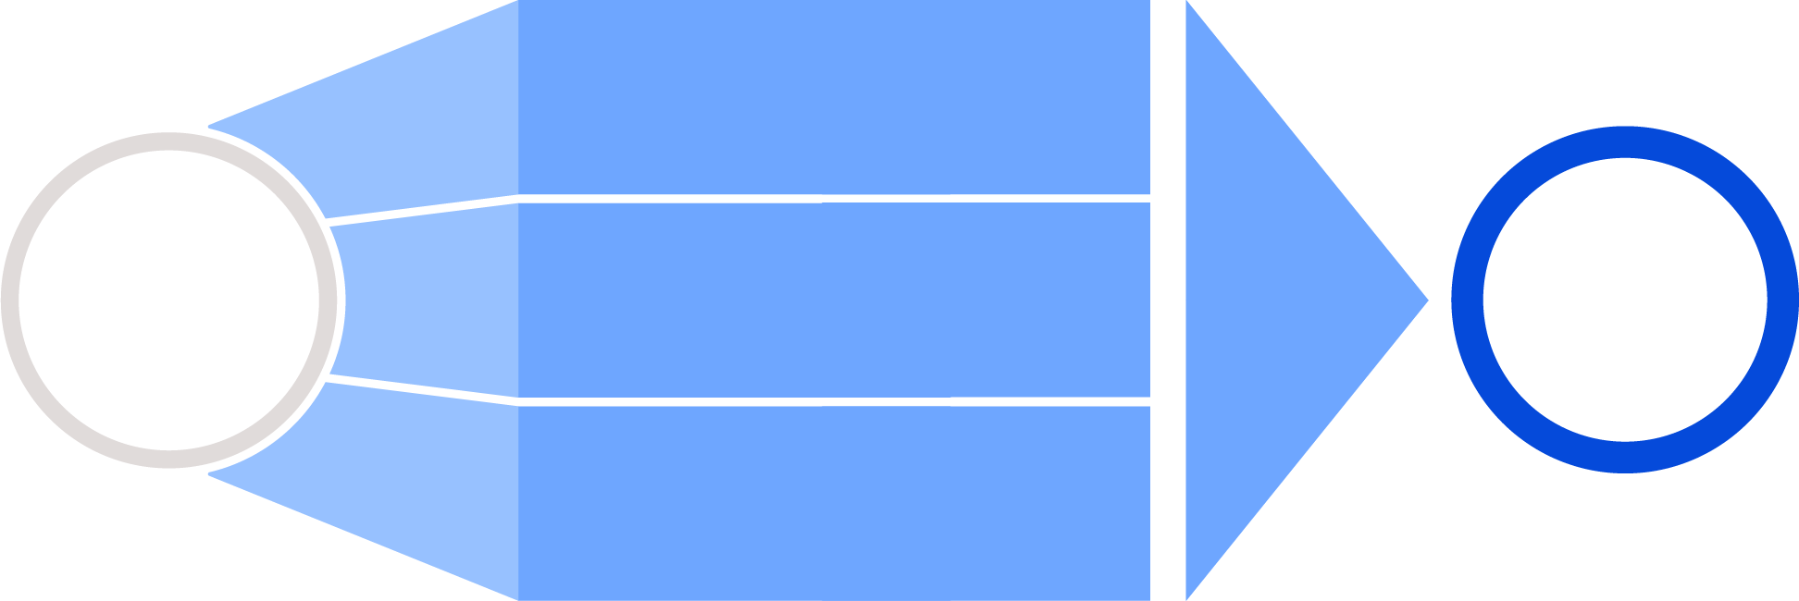
Challenges with Monolith Applications
How did We Come to Microservices?
It is difficult to deploy changes in production quickly, as the team needs to keep track of bugs in hundreds of lines of changing code.
Challenges with large monolith applications
The code becomes too big and complex for the team to understand its flow.
Solution
Microservices
Solutions
Varied priorities and schedules for developing features makes it difficult to coordinate tasks in a single release.

Slide 16
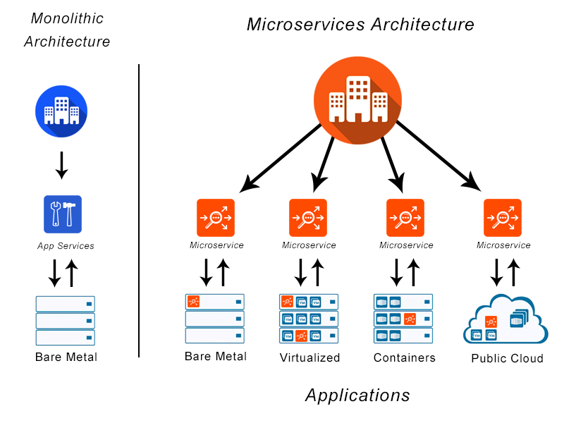
Microservices: Definition
How did We Come to Microservices?
Microservices is an architectural design for building a distributed application using containers.
Microservice gets its name because each function of the application operates as an independent service.
This architecture allows for each service to scale or update without disrupting other services in the application.
A Microservices framework creates a massively scalable and distributed system, which avoids the bottlenecks of a central database and improves business capabilities, such as enabling continuous delivery/deployment applications and modernizing the technology stack.
Source: https://avinetworks.com/glossary/microservice/

Slide 17
Characteristics of Microservices
How did We Come to Microservices?
We cannot say that there is a formal definition of the Microservices architectural style, but we can attempt to describe what we see as common characteristics for architectures that fit the label.
As with any definition that outlines common characteristics, not all Microservice architectures have all the characteristics, but we do expect that most Microservice architectures exhibit most characteristics.
Characteristics of Microservices
Componentization via services
Organized around business capabilities
Smart endpoints and dumb pipes
Products not projects
Decentralized governance
Decentralized data management
Infrastructure automation
Design for failure

Slide 18
Benefits of Microservices Architecture
How did We Come to Microservices?
Isolation
Scalability
Evolutionary
Advantages
Faster Project Development
Productivity
Flexibility

Slide 19
Reasons to shift to Microservices
How did We Come to Microservices?
Simple to develop, test, deploy, and scale
Reduces the complexity of writing large lines of code
Faster startup time - thanks to lightweight servers
Independent scaling of each service
Improves communication between Development, QA, and Testing teams
Embraces DevOps and automation
Easy to find bugs and address them quickly

Slide 20
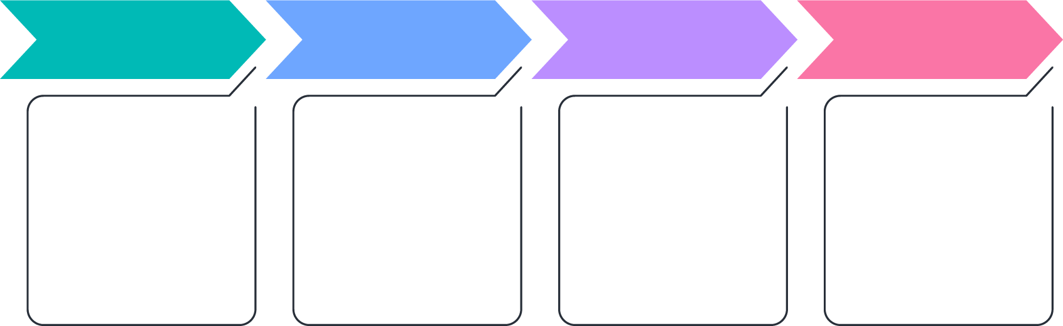
Moving to Microservices
How did We Come to Microservices?
Moving to Microservices from a monolith is a huge paradigm shift. A new culture needs to be built around how a team should handle and code their services.
This kind of transition is always incremental because it is hard to build and prepare everything beforehand. So, it is important to analyze and prioritize the base to begin with.
As the number of Microservices increases, managing them gets more challenging. It is important that management is planned before or while Microservices are being built.
While the modularity helps, things can very quickly get out of hand if not managed well. Many engineering leaders have stated that the mismanagement of these services is as much a problem as problems faced during the initial stages of the transformation from monolithic applications.

Slide 21
Moving to Microservices: Challenges
How did We Come to Microservices?
Monitoring
The traditional forms of monitoring and diagnostics will not align well with Microservices since there are multiple services making up the same functionality that was previously supported by a single application.
Finding the root cause when a problem arises in the application can be challenging, if there is no means of monitoring and tracking the path a specific request took; for example, how many and which Microservices were traversed for a specific request coming from a user interface.
DevOps
Culture
Integrating
Testing
Monitoring
Fault
Tolerance
Cyclic
Dependen-
cies
Design with failure in mind

Slide 22
Moving to Microservices: Challenges (continued)
How did We Come to Microservices?
Embracing DevOps Culture
Separate teams need agility, autonomy, and continuous delivery to be able to deliver initial releases and subsequent iterative changes. A lack of DevOps culture can bottle up releases and impact the overall time-to-market and the response to business requests and issues.
Fault Tolerance
It is important that individual services do not bring down the overall system. Fault tolerance at the service level, and more importantly, at the overall solution level, is critical. Given the complexity of a Microservices environment and the complex dependency chains, failure is inevitable. Microservices need to be able to withstand both internal and external failures. Robust resiliency testing is key to successful issue preparedness.
DevOps
Culture
Integrating
Testing
Monitoring
Fault
Tolerance
Cyclic
Dependen-
cies
Design with failure in mind

Slide 23
Moving to Microservices: Challenges (continued)
How did We Come to Microservices?
Testing
Testing is much more complex in a Microservices environment due to the different services, their integration, and interdependencies. The team members responsible for quality assurance need to be knowledgeable on the order and channels of communications between services to have full coverage in their test cases. The asynchronous aspect of Microservices also makes it harder to test in lower environments. Indistinct behaviors from Microservices are harder to predict and validate.
Design with Failure in Mind
While this is counter-intuitive to many, expecting failure scenarios and building a robust set of Microservices is imperative to a successful implementation. When more failure situations are predicted during design, more exception handling mechanisms will be built, and seamless resolution of issues will be handled better. This is easier said than done.
DevOps
Culture
Integrating
Testing
Monitoring
Fault
Tolerance
Cyclic
Dependen-
cies
Design with failure in mind

Slide 24
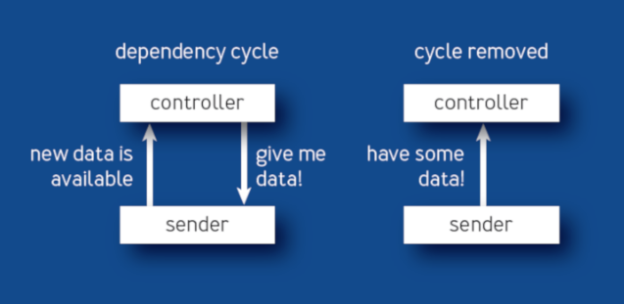
Moving to Microservices: Challenges (continued)
How did We Come to Microservices?
Cyclic Dependencies
Dependency management across different services and their functionality is very important and cyclic dependencies can be a headache if not identified and resolved promptly. In Microservice architecture, there’s even more vulnerability to errors coming from dependency issues. Decisions made around upgrades on related services with these dependencies are critical.
DevOps
Culture
Integrating
Testing
Monitoring
Fault
Tolerance
Cyclic
Dependen-
cies
Design with failure in mind

Slide 25
Driving Forces for the Move to Microservices

Slide 26
Agile + DevOps Real-time - Enabled by Cloud
How did We Come to Microservices?
Agile with DevOps real-time development and deployment and enabled by Cloud Technologies, is transforming the organization’s ability to respond to customer needs and test innovative business ideas.
Cloud
DevOps
Agile
Infrastructure availability/Scaling/Resiliency
Cost effectiveness
Automated Operations
Continuous deployment
Distributed Monitoring
Business/IT Collaboration
Frequent Release
Continuous Integration

Slide 27
Cloud: Overview
How did We Come to Microservices?
Cloud computing is the delivery of computing services – including servers, storage, databases, networking, software, analytics, and intelligence – over the Internet.
Cloud offers faster innovation, flexible resources, and economies of scale.
Clients can choose to pay only for Cloud services they use – this helps lower operating costs, run infrastructure more efficiently, and scale as per changing business needs.
Cloud
Cloud

Slide 28
Types of Cloud
How did We Come to Microservices?
Public Clouds
Whole computing infrastructure is located on the premises of a Cloud computing company that offers the Cloud services.
Private Clouds
All computing infrastructure is hosted at the client location and is not shared. The security and control level is highest while using a private network.
Hybrid Clouds
Both private and public Clouds are used – depending on their purpose. Clients host their most important applications on their own servers to keep them more secure.
Community Clouds
It is shared between organizations with a common goal or that fit into a specific community,
Public clouds are owned and operated by a third-party cloud service provider. These deliver their computing resources like servers and storage over the Internet. With a public cloud, all hardware, software, and other supporting infrastructure is owned and managed by the cloud provider. You access these services and manage your account using a web browser.
A Private Cloud can be physically located on the company’s on-site datacenter. Some companies also pay third-party service providers to host their private Cloud. A Private Cloud is one in which the services and infrastructure are maintained on a private network.
Hybrid Clouds combine public and Private Clouds, bound together by technology that allows data and applications to be shared between them. By allowing data and applications to move between private and public clouds, a hybrid cloud gives businesses greater flexibility and more deployment options, and helps optimize existing infrastructure, security, and compliance.
It is shared between organizations with a common goal or that fit into a specific community. A Community Cloud in computing is a collaborative effort in which infrastructure is shared between several organizations from a specific community with common concerns, for example, security, compliance, and so on, whether managed internally or by a third-party and hosted internally or externally.

Slide 29
Benefits of Cloud infrastructure adoption
How did We Come to Microservices?
Cost
Cloud computing eliminates the capital expense of buying hardware and software and setting up and running on-site datacenters; the racks of servers, the round-the-clock electricity for power and cooling, the IT experts for managing the infrastructure – it all adds up fast.
Speed
Most Cloud computing services are provided as self service and on demand, so even vast amounts of computing resources can be provisioned in minutes, typically with just a few mouse clicks. This gives businesses a lot of flexibility and takes the pressure off capacity planning.
Scale
The benefits of Cloud computing services include the ability to scale elastically.
Productivity
On-site datacenters typically require a lot of “racking and stacking”—hardware setup, software patching, and other time-consuming IT management chores. Cloud computing removes the need for many of these tasks, so IT teams can spend time on achieving more important business goals.
Performance
The biggest Cloud computing services run on a worldwide network of secure datacenters, which are regularly upgraded to the latest generation of fast and efficient computing hardware. This offers several benefits over a single corporate datacenter, including reduced network latency for applications and greater economies of scale.
Reliability
Cloud computing makes data backup, disaster recovery, and business continuity easier and less expensive because data can be mirrored at multiple redundant sites on the Cloud provider’s network.
Security
Many Cloud providers offer a broad set of policies, technologies, and controls that strengthen the security posture overall, thus helping protect data, apps, and infrastructure from potential threats.

Slide 30
Challenges of moving to Cloud: Complexity of operating environment
How did We Come to Microservices?
A recent Forbes article observed that “It’s a multi-Cloud world, after all” as if Cloud diversity was a new concept.
Many of the organizations have applications spread across multiple platforms.
These multiple platforms include on-premises, remote offices, co-location facilities, software-as-a-service (SaaS), hyperscale Clouds like IBM Cloud, AWS and Azure, and enterprise Clouds that operate similarly to their in-house environments.
In practice, most enterprises now understand that no single Cloud provider can meet all their business requirements.
A whopping 98% of organizations plan to adopt multi-Cloud architectures by 2021, even though only 41% have a multi-Cloud management strategy, and even fewer have adapted their processes and tools for multi-Cloud operations.
Put another way, management complexity is a common byproduct of multi-Cloud environments.
It is now safe to say that interoperable on-premises infrastructure and hybrid multi-Clouds are common enterprise IT architectures, and they are likely to remain so for several years to come. However, getting these distributed environments to operate efficiently and effectively to better serve the business needs of enterprises is another matter.

Slide 31
Customer expectations
How did We Come to Microservices?
By definition, customer expectations are any set of behaviors or actions that individuals anticipate when interacting with a company. Historically, customers have expected basics like quality service and fair pricing.
However, modern customers have much higher expectations, such as proactive service, personalized interactions, and connected experiences across channels.
Disruptive companies leverage breakthroughs in Cloud, mobile, social, and artificial intelligence technologies to deliver personalized, valuable, and immediate experiences, hence, providing customers with more choices.
As a result, they grow to expect this superior experience from any business that they engage with.

Slide 32
Agile
How did We Come to Microservices?
Significance of Agile Microservice architecture
Agile development methodology ideally suited to Microservices
Digital transformation projects are executed in a world of growing uncertainties. This leads to the need to rapidly change or modify software implementations as our clients’ requirements shift.
Agile allows us to develop, package and deploy isolated and self-contained parts of the overall software application individually.
In microservices you have small teams working together, focused on specific areas. In much the same way, the Agile Manifesto recommends that successful and efficient teams are those that comprise of 6-8 people , who are empowered to make the necessary decisions.
Agile provides the structure for teams to work together effectively when handling applications on a microservices architecture.

Slide 33
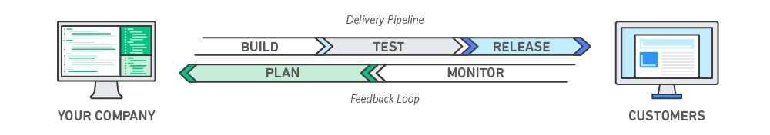
DevOps
How did We Come to Microservices?
DevOps is the combination of cultural philosophies, practices, and tools that increases an organization’s ability to deliver applications and services at high velocity, thus evolving and improving products at a faster pace than organizations using traditional software development and infrastructure management processes.
This speed enables organizations to better serve their customers and compete more effectively in the market.

Slide 34

Q&A

Slide 35

Summary
How did We Come to Microservices?
Summary

Slide 36

Appendix
How did We Come to Microservices?
Appendix
Challenges in implementing Microservices
What is Cloud computing?

Slide 38
Isolation
Microservices are profitable due to their isolation and resilience. If one of the components fail, developers have the option to use another service and the application will continue to run independently. This way, engineers can build and deploy services without the need to change the whole app.
Scalability
With the architecture of microservices based on small components, it’s easier for development teams to scale up or down following the requirements of a specific element. Isolation allows apps to run correctly when massive changes are happening. Microservices prove to be the perfect approach for companies working with various platforms and devices.
Productivity
Part of functionality associated with microservice architecture is the ability to easily understand when compared to an entire monolithic app. If you plan to expand your development team, microservices are a better pick.
Flexibility
The microservice approach lets developers choose the right tools for the right task. They can build each server utilizing a language or framework they need without affecting the communication between microservices.
Faster project development
Microservices work independently, so you don’t have to change the codebase in order to modify the features. You can change one component, test, and then deploy it individually. In turn, you will deliver the app faster.
Evolutionary
Microservice architecture is a perfect choice for developers unable to predict the kinds of devices the app is going to run on. Developers can provide fast and controlled upgrades through not slowing down or stopping the apps.

